Slide 1
SMALL PRECISION TOOLS
Wedge Auto-Draw Requirements
Small Wire (SW) Wedge Series – M Series – Microwave Bonding Tools
Requirements
DOCUMENT NO.
DATE
PREPARED BY
STATUS
M_REQ_Rev0_07202026
2026-21-07
Youssef
Draft

Slide 2
Scope
This document defines the production drawing, customer drawing, and overlay requirements for the M Series – Microwave Bonding Tools
Requirements series, covering both the finished wedge and the Pre-Ground Blank (PGB). Including M45A, M45B
SMALL PRECISION TOOLS
Confidential
04

Slide 3
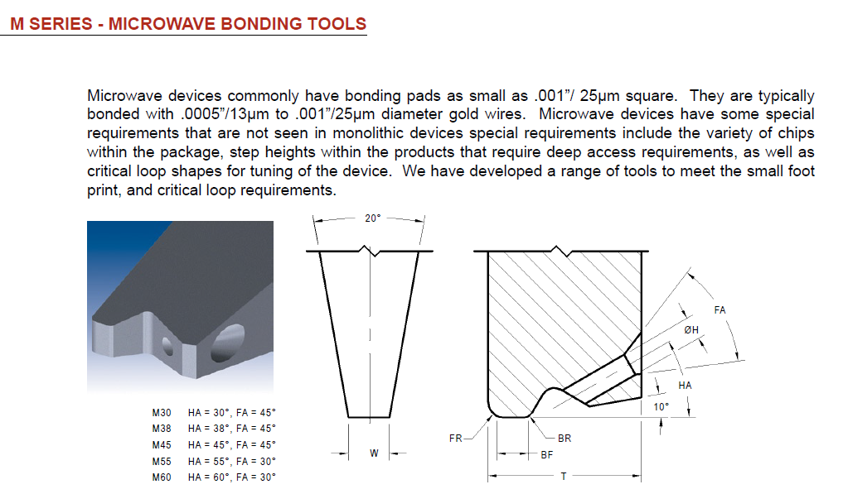
Tool Overview
SMALL PRECISION TOOLS
Confidential
04

Slide 4
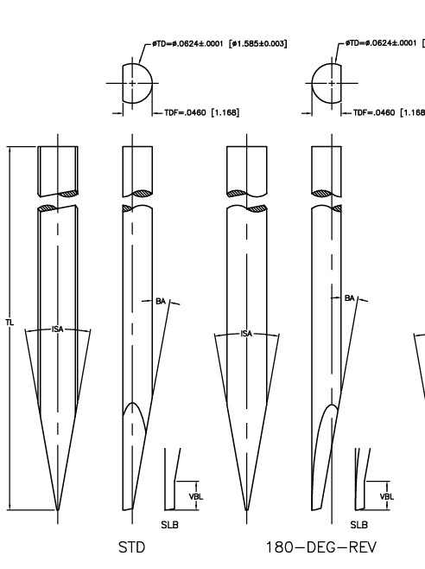
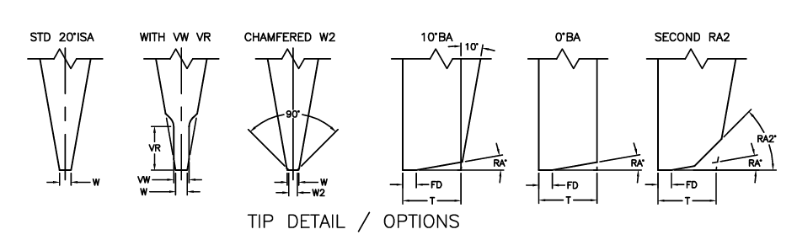
Configuration Options
Shank: SW_STD with SLB feature , SW_180REV with SLB feature
For Tip detail we have STD 20°ISA , WITH VW VR , CHMFERED W2, 10°BA, 0°BA, SECOND RA2
SMALL PRECISION TOOLS
Confidential
04

Slide 5
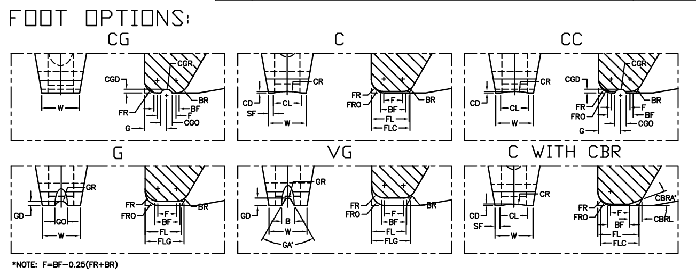
Configuration Options
Foot options: SW_C, SW_F, SW_CG, SW_G, SW_VG, SW_CC
SMALL PRECISION TOOLS
Confidential
04

Slide 6
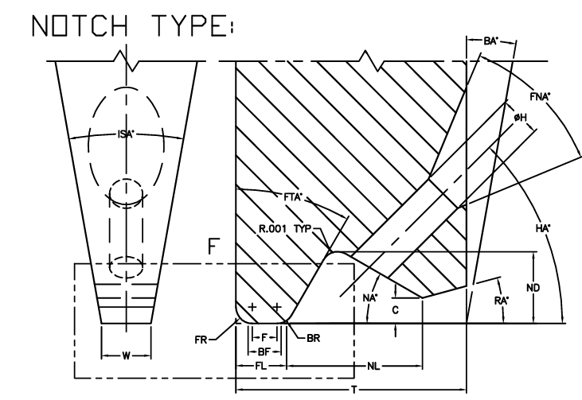
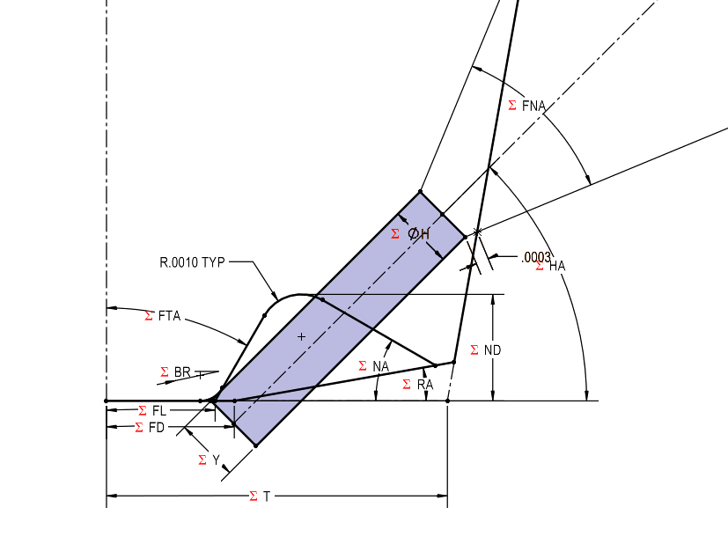
Configuration Options
Notch type: SW_L-Notch,
Note : No need for the C value
SMALL PRECISION TOOLS
Confidential
04

Slide 7
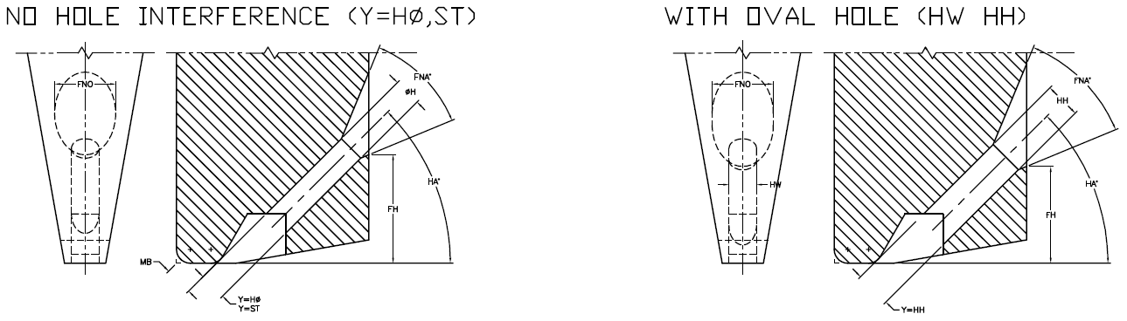
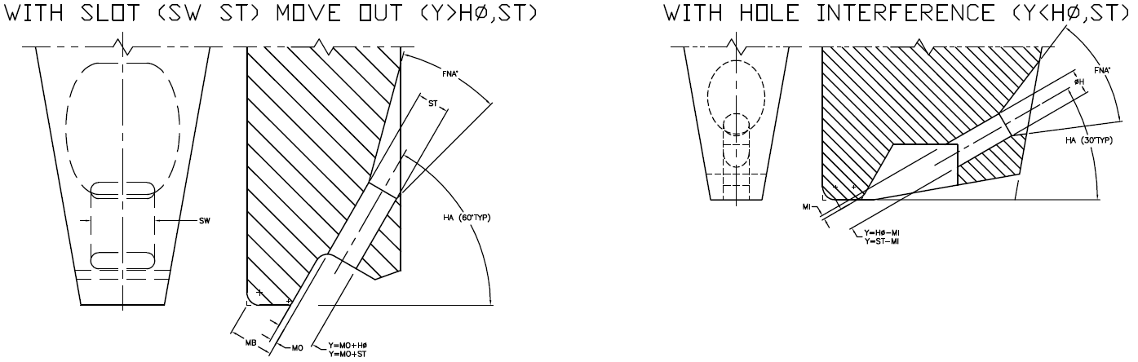
Configuration Options
Feed hole types: STD (Round), Oval, Slot
Note : Y will be used to position the hole
SMALL PRECISION TOOLS
Confidential
04

Slide 8
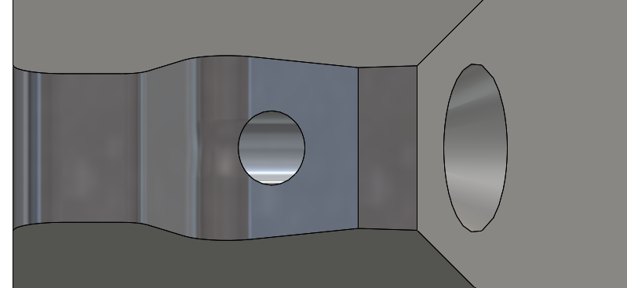
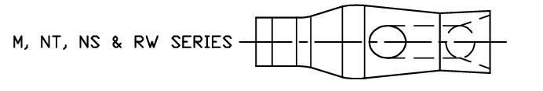
Configuration Options
BR feature: N/A
Note :
SMALL PRECISION TOOLS
Confidential
04

Slide 9
Database Requirements
Schema is largely consistent with the COB tool family.
Part_Spec | PN | Filter | Drawing_Number | Description_2 | Wed-Type | Wed-Foot_Option | Wed-Wire_Exit | Wed-Feed_H/Slot
117627 | 3112545 |  | 14003377 | M45A-WH-1510-3/4-F | SW_STD | SW_F | SW L Notch | STD(Round)
117625 | 3112546 |  | 14003377 | M45A-WH-1510-S-F W=.003 | SW_STD | SW_F | SW L Notch | STD(Round)
117641 | 3112756 |  | 14001389 | M45A-TI-1515-S-FM W=003 | SW_STD | SW_F | SW L Notch | STD(Round)
117802 | 3112760 |  | 14003533 | M45A-TI-2020-S-FM | SW_STD | SW_F | SW L Notch | STD(Round)
Note : We may need to add the fields like Wedge type; Foot type; etc. Note : We will need to add some rules of data handling !
SMALL PRECISION TOOLS
Confidential
04

Slide 10
Customer Drawing Requirements
For customer drawing we will replicate as the same provided, following the same step as COB
Front, Right & Top Views
Detail & Section Views
Dimensions Tables
Note : Noticed the VFL has an angle, but Not define in the DB
SMALL PRECISION TOOLS
Confidential
04

Slide 11
Production Drawing Requirements
For customer drawing we will replicate as the same provided, following the same step as COB
Front, Right & Top Views
Detail & Section Views
Dimensions Tables
Add all dimensions and parameters to views
Note : The production drawing will follow the same as sample provided
SMALL PRECISION TOOLS
Confidential
04

Slide 12
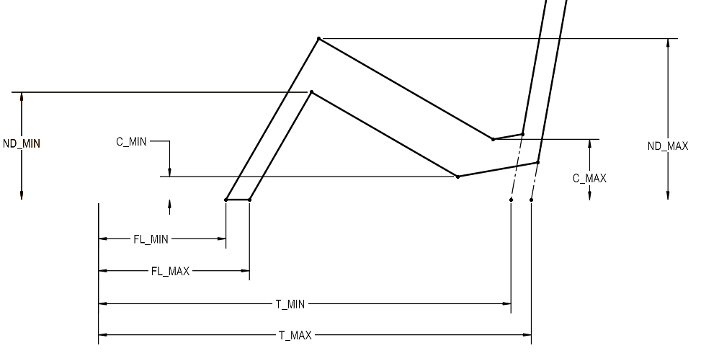
Overlay Requirements: Finish Wedge
Like COB overlay, with different tolerance zone construction. .
Note : Scaling the view the same way as COB, The T dimension start from TDF Note : Only add two views to the overlays Note : No need to all the annotations
SMALL PRECISION TOOLS
Confidential
04

Slide 13
Overlay Requirements: PGB
Remains unchanged from the standard wedge overlay used across all tool families. Feed Hole added
Note : The PGB may have the VR/VW version !
SMALL PRECISION TOOLS
Confidential
04

